Slide 1
Leech Lake Suicide Prevention Efforts through Community Partnerships
National Behavioral Health Conference
August 16, 2017
Sherri Newago
Cass Lake Hospital MSPI Project Coordinator

Slide 2
Leech Lake Prevention Efforts through Community Partnerships
Funded by the department of health and Human services, Division of Behavioral health

Slide 3
Objectives:
Participants will increase knowledge of the Columbia-Suicide Severity Rating Scale as it is used in a community setting.
Participants will learn how improved communication processes can improve coordination and reduce siloed interventions.
Participants will learn how community engagement promotes sustainability and ownership in the process.

Slide 4
Partnerships
Cass Lake Hospital
Leech Lake Tribal College
Cass Lake-Bena ISD
Leech Lake Behavioral Health
Bug-O-Nay-Ge-shig School

Slide 5
Brief Project Overview
The Leech Lake suicide prevention effort is community-wide. Cass Lake Hospital is addressing suicidal ideation presentations through implementation of a four member Suicide Prevention Team. The Project Coordinator and the Traditional Healer provide community outreach throughout the Leech Lake Nation, collaborating with community partners to offer/coordinate cultural activities to promote cultural health in all dimensions and reinforce the importance of cultural identity as a resiliency factor.

Slide 6
Brief Project Overview cont’d
The MSPI Team works to create a health care culture that encourages the community to seek help for mental health problems; a culture in which mental health problems do not need to be hidden, secretive, or stigmatized; a culture that allows the community to obtain the mental health services that are needed for healthier life styles.

Slide 7
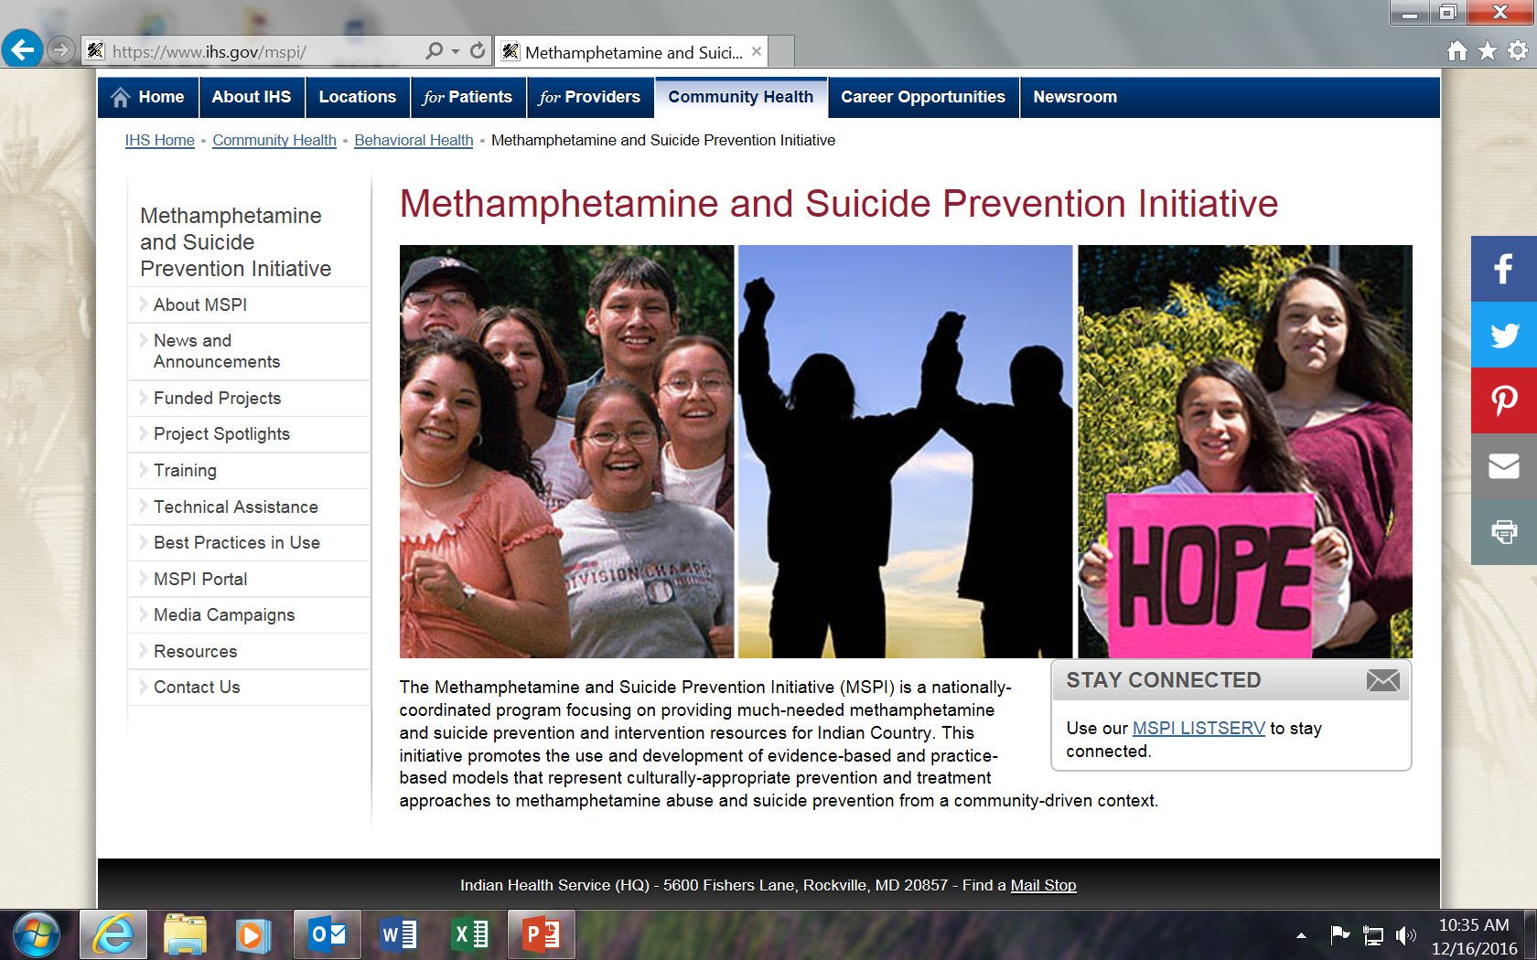

Slide 8
Efforts so far…
Calm Group
Identifying Universal Screening Tool
Training
Quarterly meetings to discuss:
Processes
Ways to improve
Identify gaps in services
Take pride in our efforts
2016 National Behavioral Health Conference:
Identified universal screening tool recommended by international experts: the Columbia-Suicide Severity Rating Scale
School social workers & counselors are being trained. Two sessions so far with 12 people trained. Another one coming soon…

Slide 9
Efforts continued
Cultural Advisor
Meth Support Group
Women’s Group
Enhancing networks with our partners
Working with individuals/families providing cultural re-connection through Ojibwe language and ceremonies
Cass Lake Hospital is sponsoring a methamphetamine support group every other week at the hospital facilitated by an ex-meth user (clean and sober for 2 years)
Educational group to empower women through knowledge of subjects at their request. Two listening sessions were held. Still in the “conceptualization stage”

Slide 10
Where We Are With the Team
Cultural Advisor
Project Coordinator
Psychiatric Mental Health Nurse Practitioner
Rosemarie DeBungie was hired on August 8, 2016. She is the first cultural advisor in the Indian Health Service.
☺
Sherri Newago was hired March 6, 2017.
☺
Not hired yet. Announced January 29, 2016. No one has applied. Closed December 31, 2016. It was re-announced. One person has applied.
☺

Slide 11
Team continued
RN Care Coordinator
Not announced yet.
☹

Slide 12
The Columbia-Suicide Severity Rating Scale was accepted as the universal screening tool.
The MSPI Project Coordinator trained school social workers in the use of the C-SSRS during the spring and summer of 2016.

Slide 13
Implementation of the
C-SSRS began in September 2016.

Slide 14
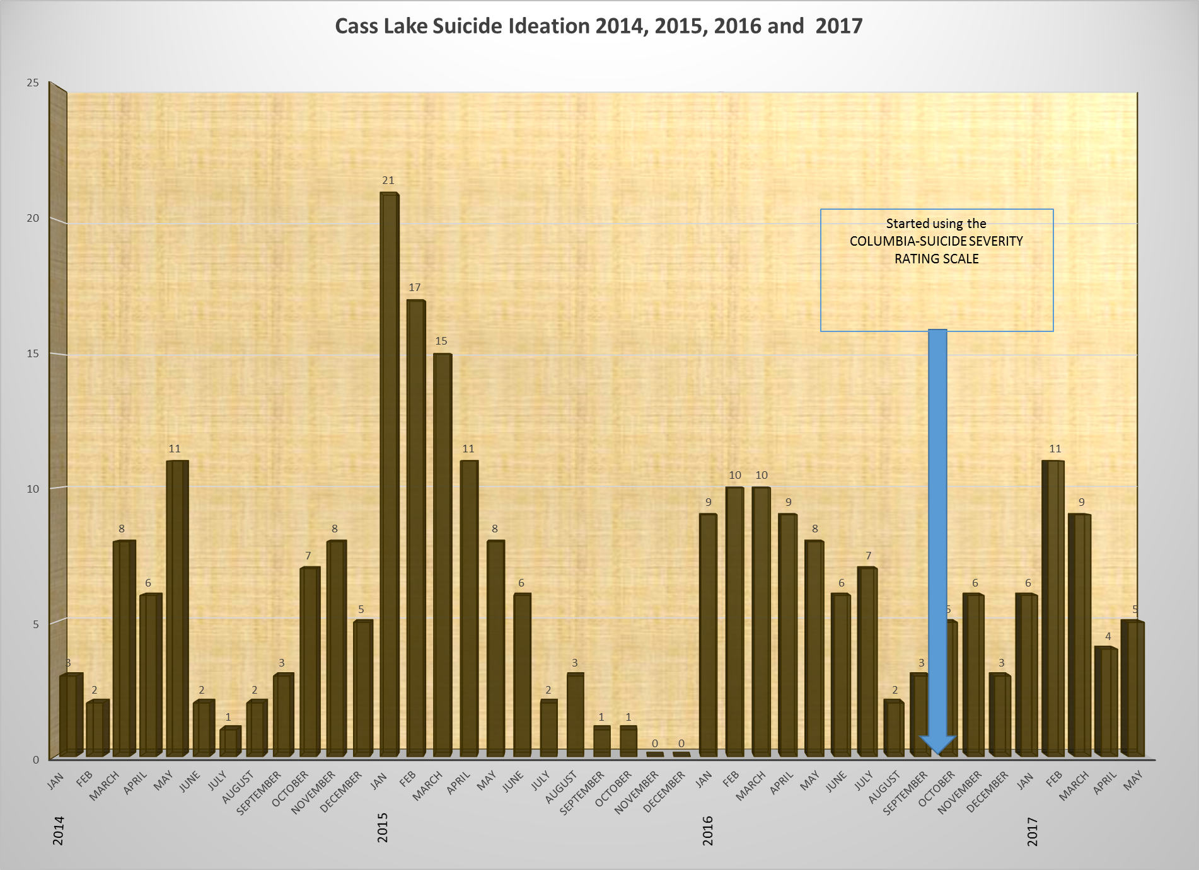
Patients presenting with suicidal ideation before and after C-SSRS

Slide 15
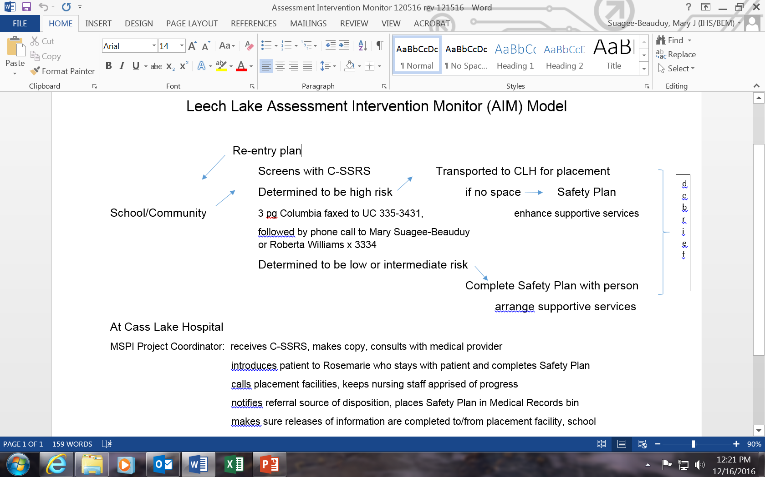
The AIM Model

Slide 16
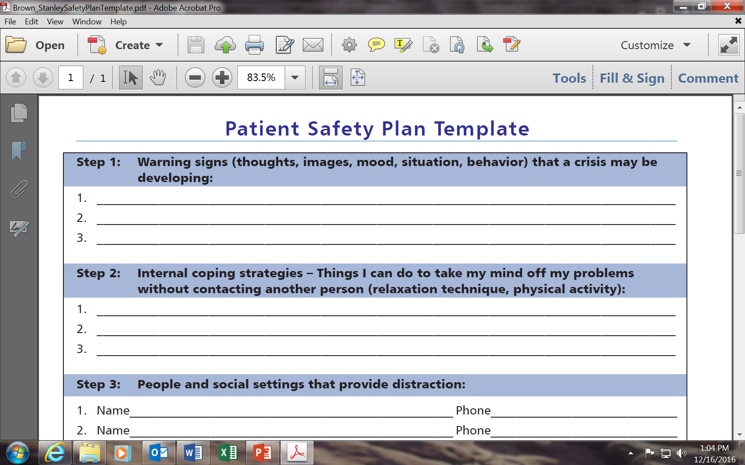

Slide 17
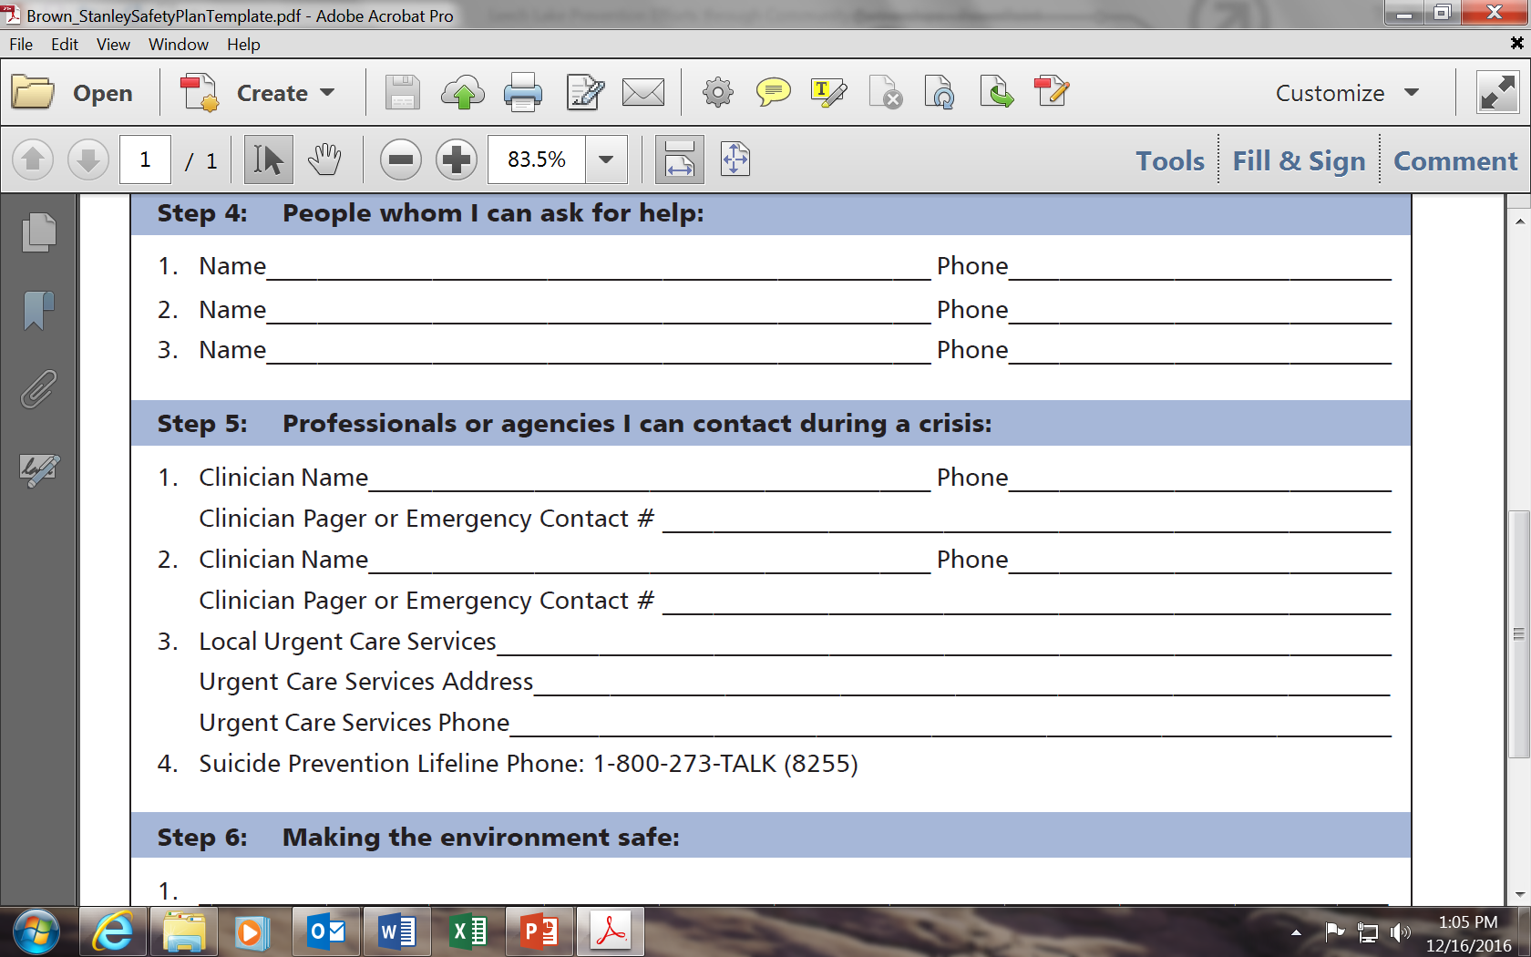

Slide 18
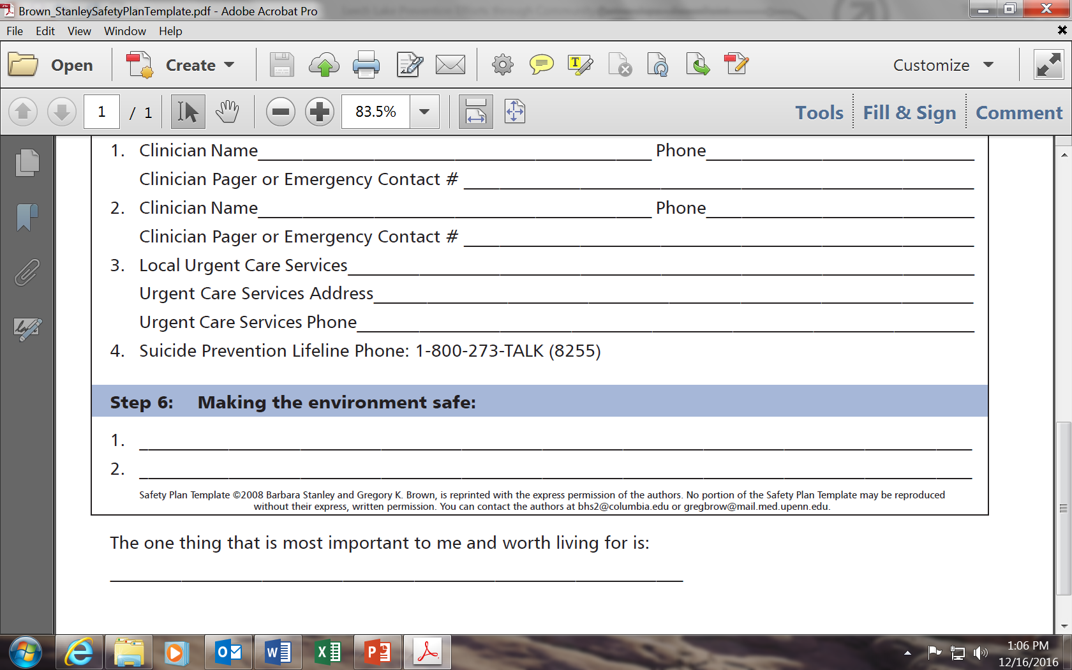

Slide 19
Expected Outcomes
Preventing escalation of solvable situations
Identifying & connecting appropriate community resources with those who need them
Reducing the number of students/patients who present to Urgent Care with suicidal ideation
Limiting the number of psychiatric admissions to those who really need them

Slide 20
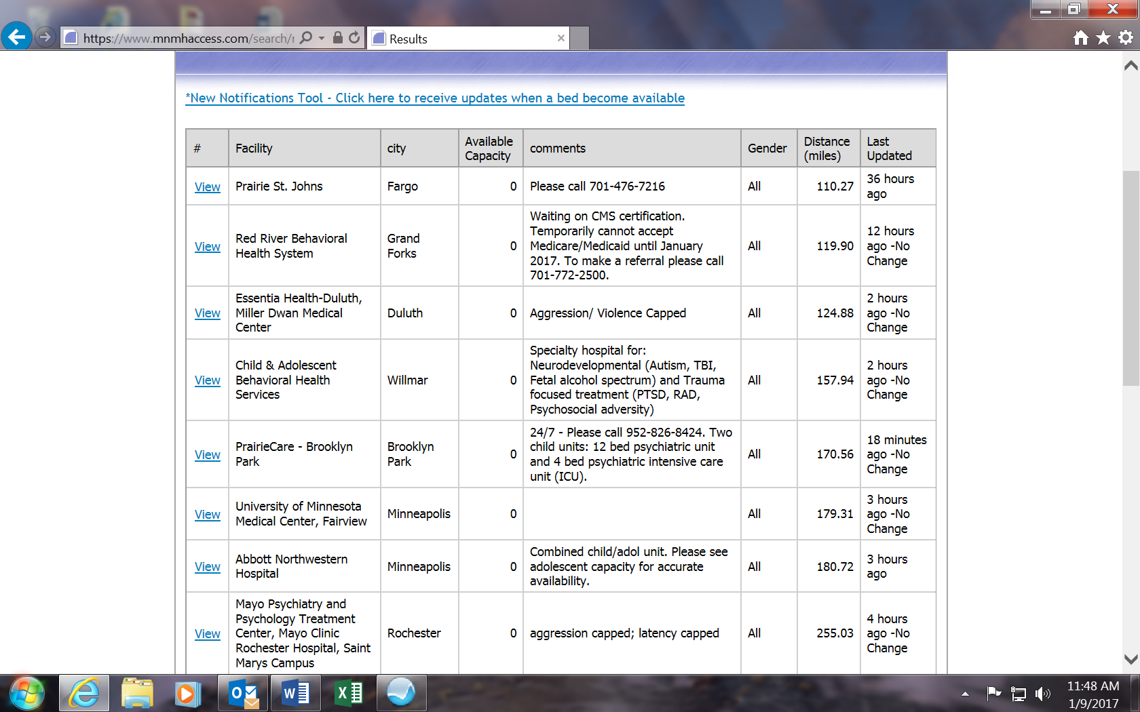

Slide 21
Suicide Prevention Trainings
*Question, Persuade, Refer > Stephanie Downey
SafeTALK> National Alliance on Mental Illness (NAMI)
ASIST> Meghann Levitt
*Means Restriction Education> Stephanie Downey
txt4Life> Stephanie Downey
* Have been provided to the hospital staff

Slide 22
Results so far…
Resources are offered at the point of identified need (in the school).
Students feel supported in their time of crisis.
Fewer patients are being sent to Urgent Care without being screened in the community.
Fewer patients are sent to psychiatric facilities.

Slide 23
Results cont’d
Enhanced communication among providers.
Providers (MSPI Team, social workers/doctors) have a sense of pride in the process.
Guided by the Calm Group (school social workers, behavioral health providers, hospital staff, and law enforcement).
Medical staff are grateful. ☺

Slide 24
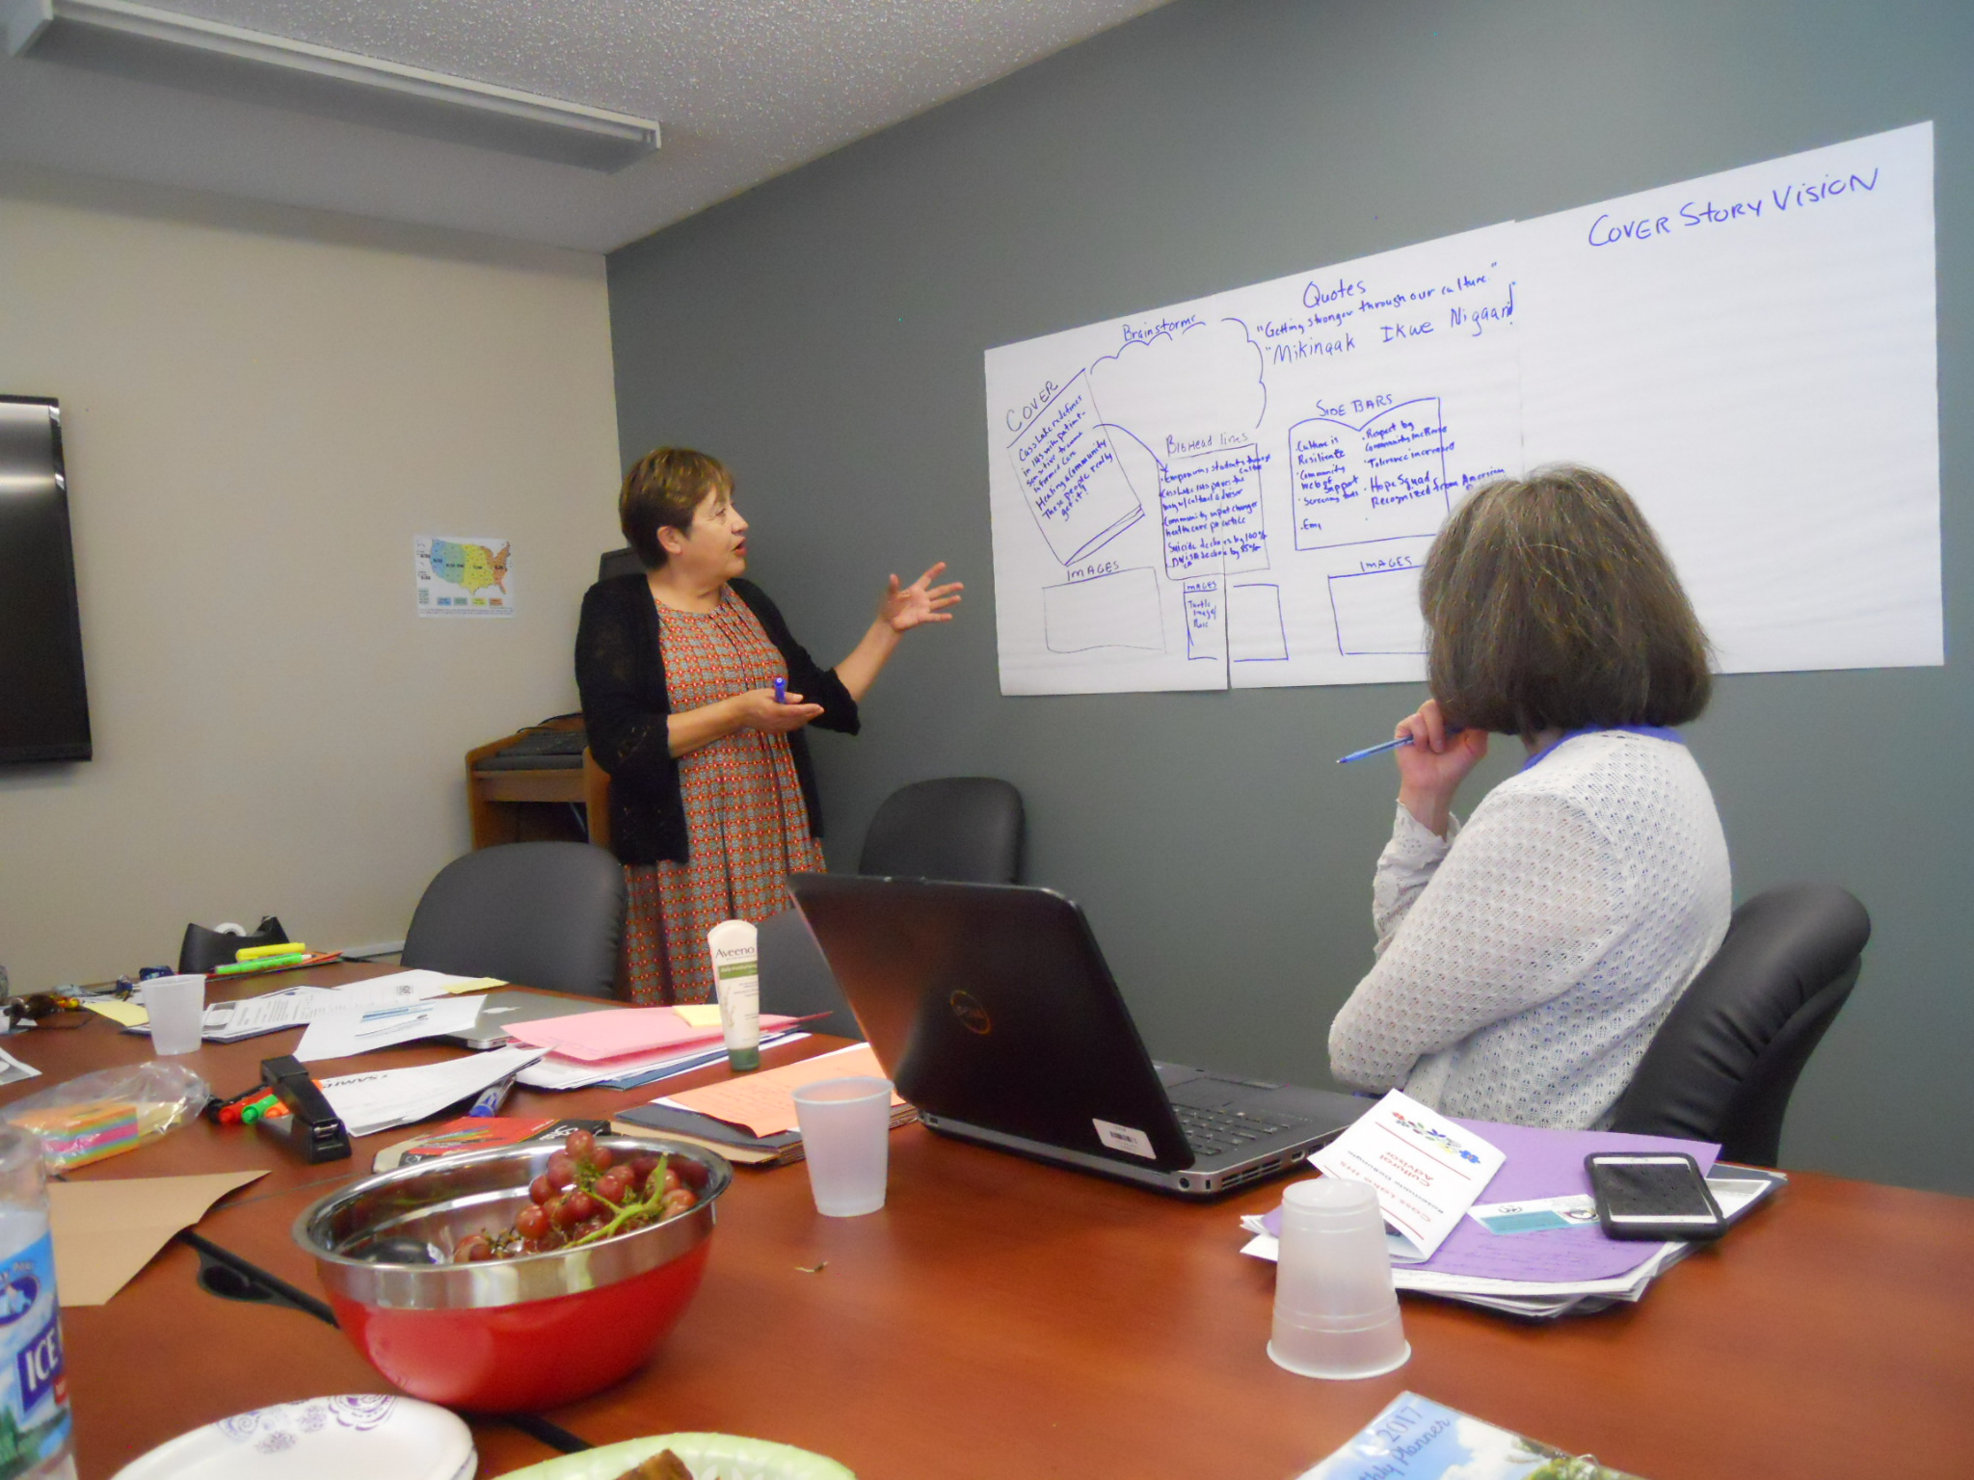
Next steps: Community Readiness

Slide 25
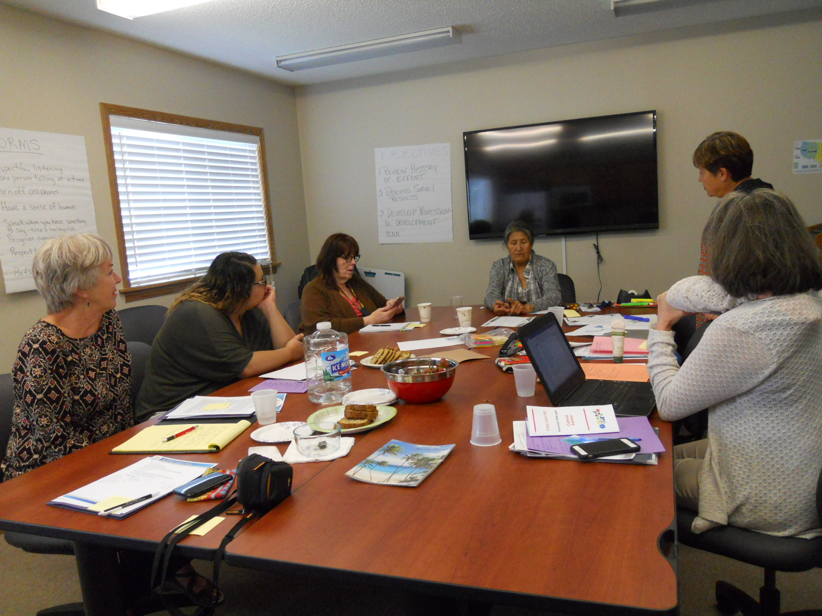
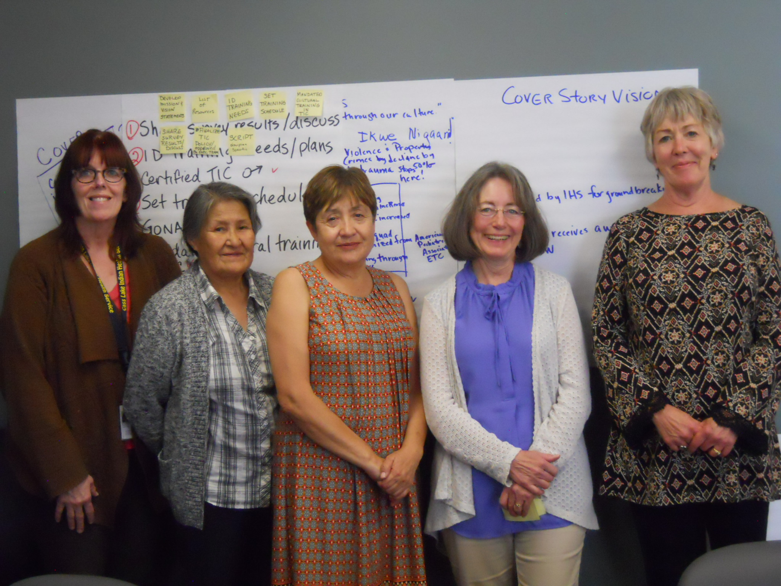
SAMHSA Tribal Connections TTA

Slide 26
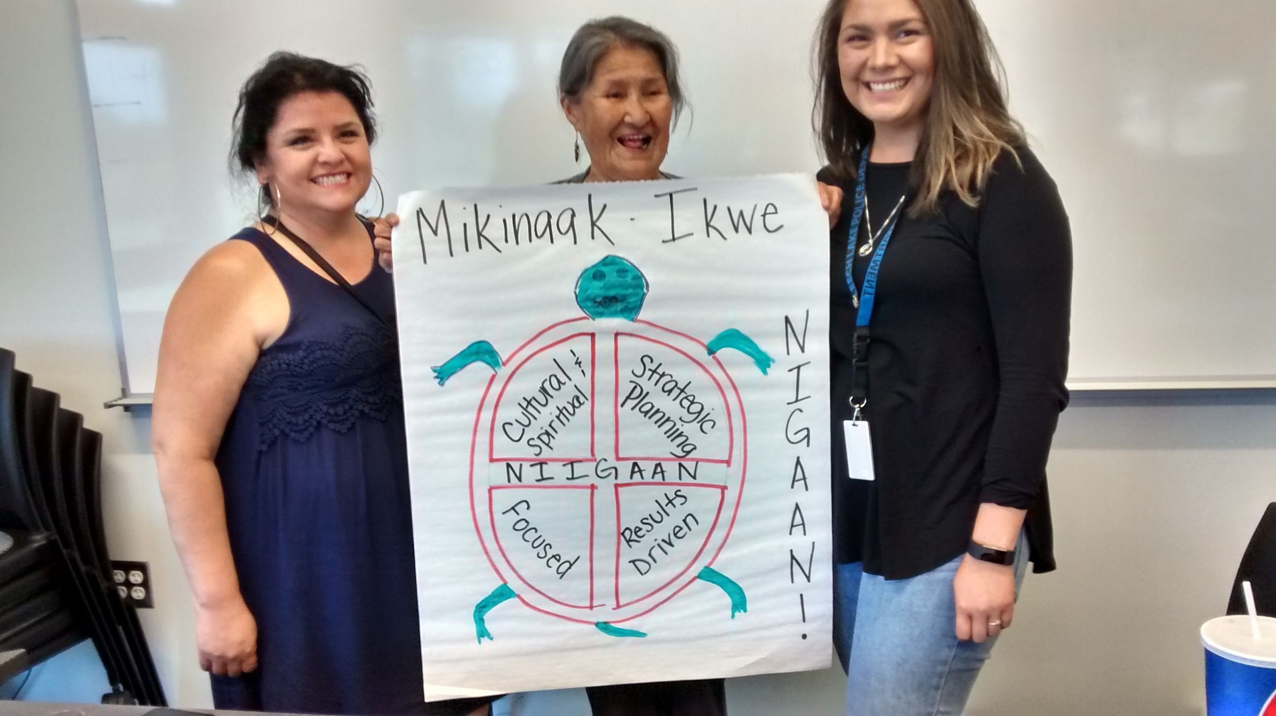
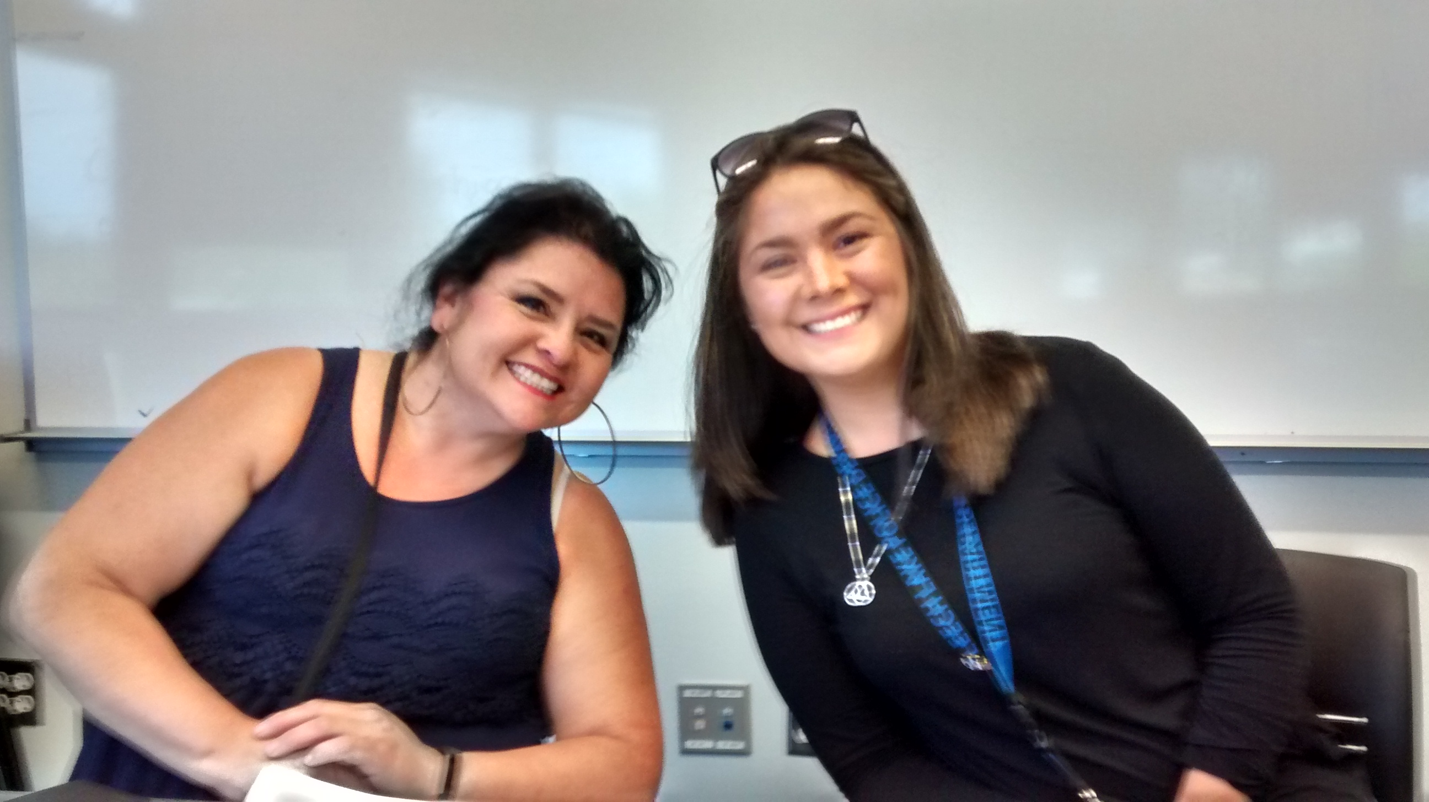
Logo Development & Marketing

Slide 27
Miigwech!
Questions?
Sherri.newago@ihs.gov 218-335-3212

